Slide 1
ORGANISATIONAL
BEHAVIOUR
CHAPTER-10
APPLIED MOTIVATION PRACTICES

Slide 2
LEARNING OBJECTIVES
There are several motivational practices available in the hands of managers
Rewards are powerful motivators. Organizations disperse four types of rewards: membership and seniority, job status, competency and performance.
Next to rewards, job itself is a powerful motivator. Job design- the process of assigning tasks to a job-is an important tool that can be used to motivate employees.
OB Mod is another motivational practice. OB mod is based on the law of effect which states that the repetition of a behaviour depends upon its consequences.
Empowerment – a feeling that an employee owns his or her job-motivates people considerably.
Goal setting is motivating people by establishing performance goals.
Every organization will have problem employees and they need to be motivated.
QWL is a powerful motivational practice.
MBO, flexi time, flexi benefits, and the like also help motivate employees

Slide 3
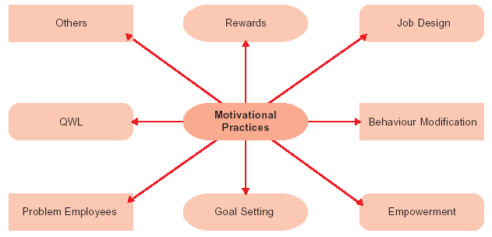
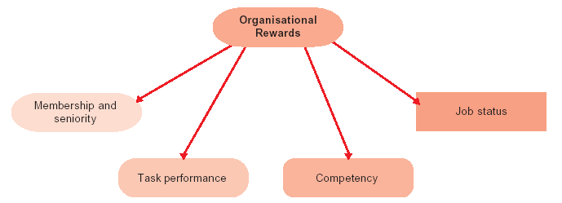
Motivational Practices
Types Of Organisational
Rewards

Slide 4
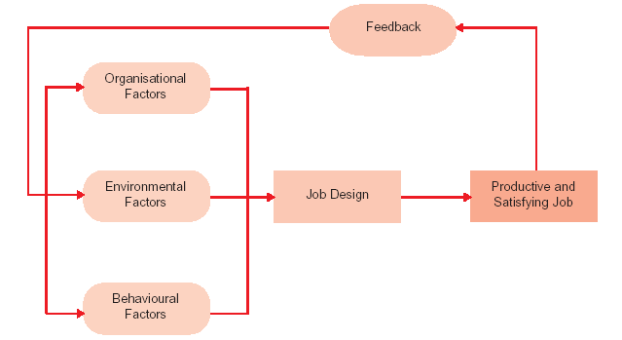
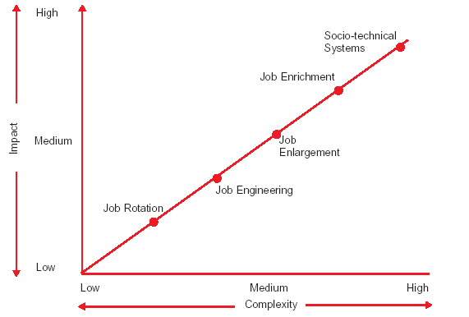
Factors Affecting Job Design
Comparison Of Five Job
Design Approaches

Slide 5
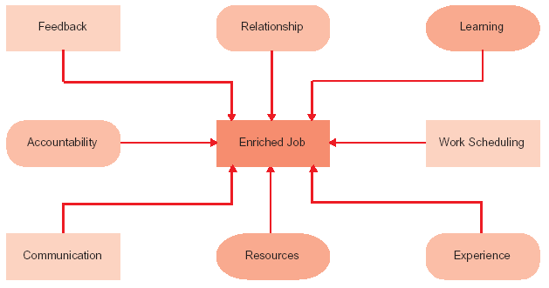
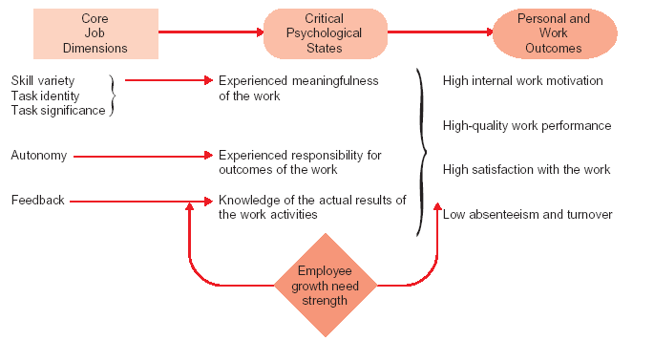
Characteristics Of
An Enriched Job
Job Characteristics
Model

Slide 6
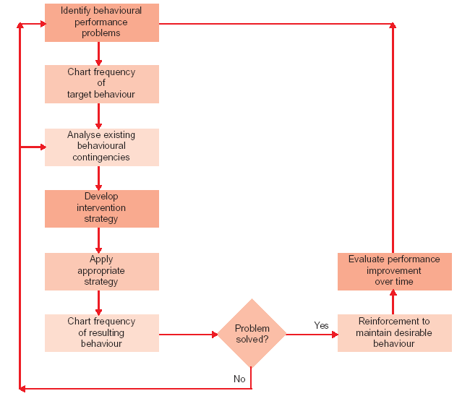
Framework of ob Mod

Slide 7
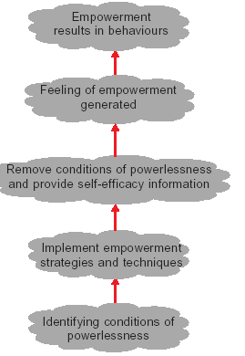
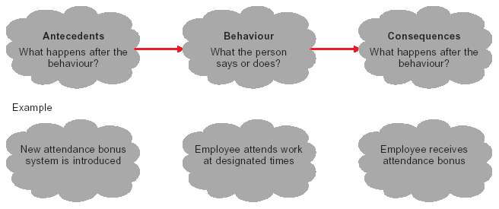
A-B-C of Behaviour Modification
Empowerment Stages

Slide 8
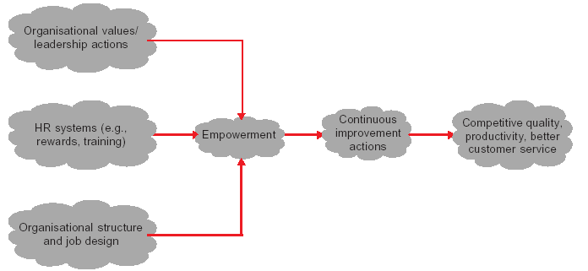
Faciliators of Empowered Teams

Slide 9
Profile of B Players
• They are not stars. Neither are they laggards. They do their jobs competently, steer the course, and define the organization’s values and culture.
• They receive the least attention from the top management, since they are unambitious and unexiting.
• They make up five per cent of any company’s bell curve.
• The B player is the wheel in an organizational machine that never squeaks and hence never gets any lubricant.
• They maintain perfect work-life balance.
• They differ from stars (A players) not in intelligence but in drive and attitude.
• They stick on with an organization, because they value the comaraderie and security of a known team. But they do leave, when things are mismanaged.
• They are the solid citizens, the juggernauts who give stability to organizations.

Slide 10
Summary
        This chapter focuses on certain practices which help motivate employees.
        Most powerful motivators are rewards which in themselves include four types: membership and seniority, job status, competency and performance.
        Job design-the process of assigning tasks to a job-can be an effective tool to motivate employees. There are six approaches to job design: job rotation, job enlargement, job enrichment, social technical systems and ergonomics.
        OB Mod is based on the principle of law of effect. The principle states that repetition of a behaviour depends upon its earlier consequences.
        If consequences of the previous action are positive, the behaviour tends to get repeated. Being based on the principle of law of effect, OB Mod acts as a powerful motivator.
        Empowerment is another motivational practice. Empowerment makes employees believe that they own the jobs.
        Goal setting too is a powerful motivational practice. Performance goals, if properly set, will motivate employees considerably.
        Problem employees need to be given one more chance, probably by shifting them to a new work environment. If they fail to respond, suspension of workers and firing of managers need to be resorted to.
        Flexi time, MBO, flexible benefits and other such practices also help motivate employees.

Slide 11
Key Terms
Motivational practices
Skill based pay
Job design
Job rotation
Job enrichment
A-B-C of behaviour modification
Goal setting
QWL
Flexi time
Organizational rewards
Job-based pay
Ergonomics
Job enlargement
OB Mod
Empowerment
Problem employees
MBO

